Slide 1
Parking in Pittsburgh, PA
By: Morgan Engel

Slide 2
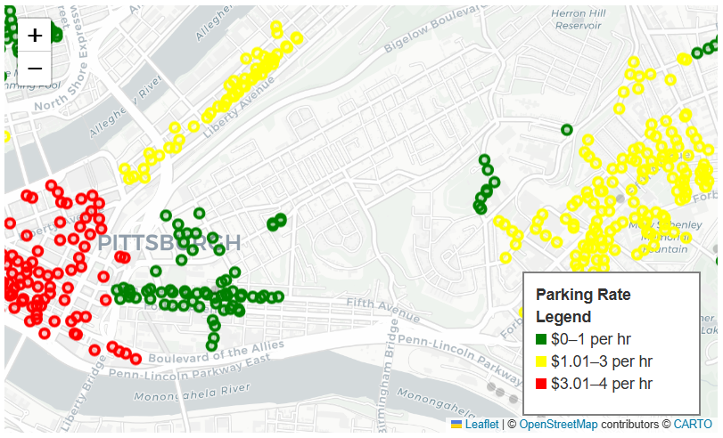
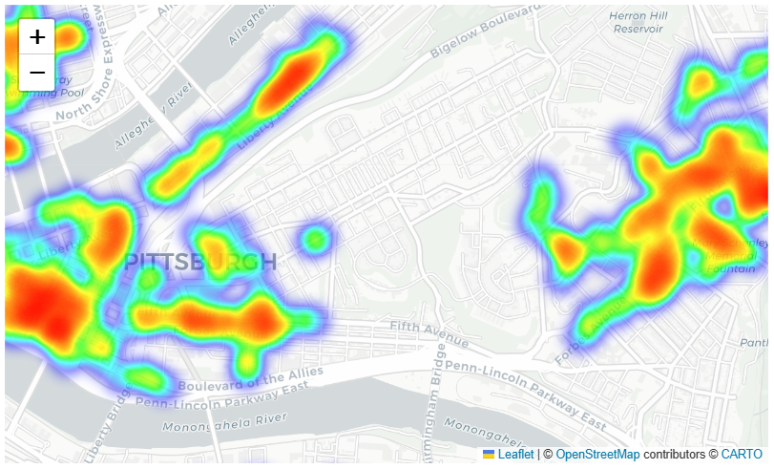
Bubble Map
Heat Map

Slide 3
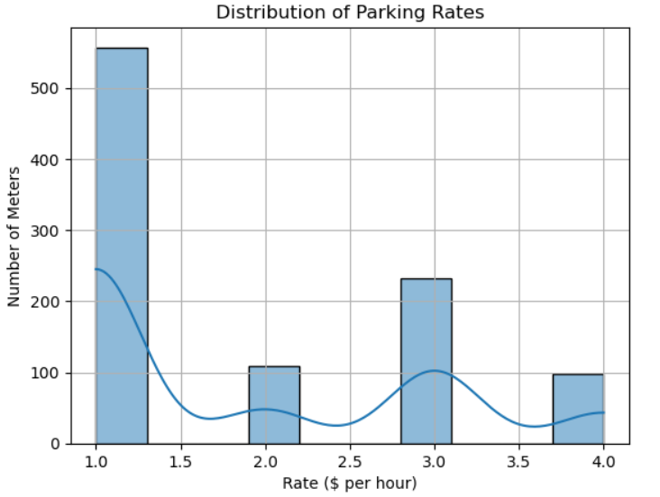
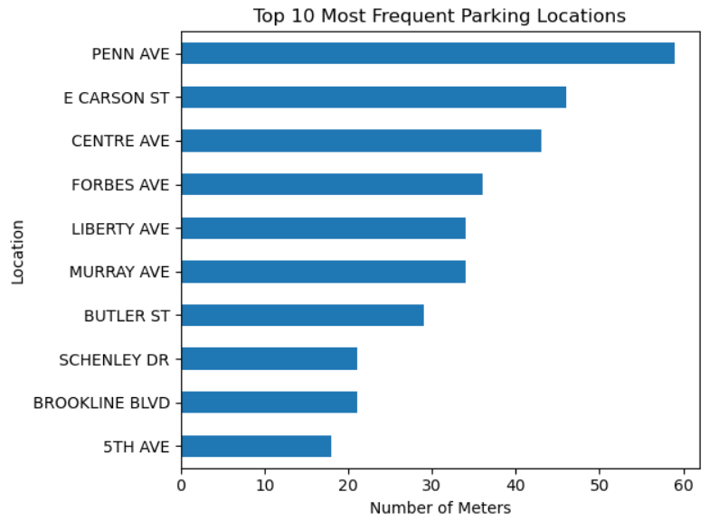

Slide 4

Thank you for listening!!!

